Slide 1
Prediction of Bank Marketing Based on Machine Learning
Xin Li, Weijie Guan
5/12/2019

Slide 2
CONTENT
01 Motivation
02 Data Processing
03 Approach
04 Result
05 Conclusion

Slide 3
01
Motivation

Slide 4
01
Motivation
1. Efficiency
Traditional ways(i.e. phone call) to find clients are inefficient
2. Improvement
New machine learning approaches to improve the performances of models

Slide 5
02
Data Processing

Slide 6
02
Data Explore
Step 1
Step 3
Draw histogram, scatter plot
Smote approach to balance dataset
Step 2
Step 4
Transfer string into numeric
Ready to input data to our models

Slide 7
03
Approach

Slide 8
03
Approach
Four algorithms are implemented:
Logistic Regression
Random Forest
Neural Network
XGBoost

Slide 9
03
Approach
Model Merging: Blending
Definition:Combine the decisions from multiple models to improve the overall performance

Slide 10
04
Result

Slide 11
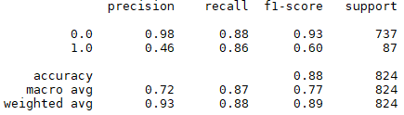
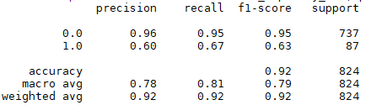
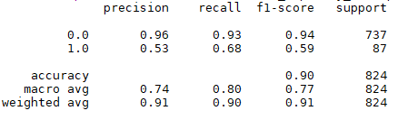
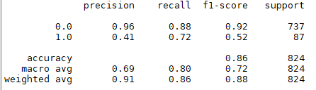
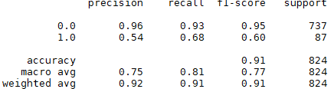
04
Result
Logistic Regression
XGBoost
Random Forest
Neural Network
Blending

Slide 12
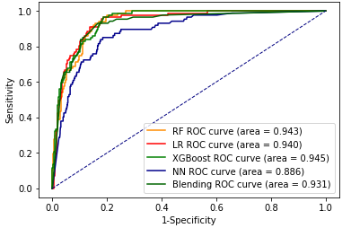
04
Result
ROC

Slide 13
05
Conclusion

Slide 14
05
Conclusion
1. F1-scores: XGBoost, RF and Blending Model(nuance differences)
2. Recall: XGBoost vs Logistic Regression
3. Overall: XGBoost

Slide 15
06
References

Slide 16
06
References
[1] S. Moro, P. Cortez and P. Rita. A Data-Driven Approach to Predict the Success of Bank Telemarketing. Decision Support Systems, Elsevier, 62:22-31, June 2014
[2] S. Moro, R. Laureano and P. Cortez. Using Data Mining for Bank Direct Marketing: An Application of the CRISP-DM Methodology. In P. Novais et al. (Eds.), Proceedings of the European Simulation and Modelling Conference - ESM'2011, pp. 117-121, Guimaraes, Portugal, October, 2011. EUROSIS. [bank.zip]
[3] Wikipedia, Logistic regression, https://en.wikipedia.org/wiki/Logistic_regression
[4] Raghav Aggiwal, Introduction to Random forest https://dimensionless.in/introduction-to-random-forest/, Feb 28, 2017
[5] How XGBoost Works, https://docs.aws.amazon.com/sagemaker/latest/dg/xgboost-HowItWorks.html
[6] David Fumo, A Gentle Introduction To Neural Networks Series, https://towardsdatascience.com/a-gentle-introduction-to-neural-networks-series-part-1-2b90b87795bc, Aug 4, 2017

Slide 17
07
Questions

Slide 18
THANK YOU FOR WATCHING
Xin Li, Weijie Guan
5/12/2019

